Slide 1
Ontology Building in Action
Hasan TÜRKSOY
Compiled, partly based on various online tutorials and presentations, with respect to their authors

Slide 2
RDF/OWL in Protégé
Example
Notes:
[6]

Slide 3
How to build an ontology?
Steps:
determine domain and scope
enumerate important terms (concepts)
organize the terms (concepts)
paraphrase and formalise the definitions
define classes and class hierarchies
define slots
define slot restrictions (cardinality, value-type)
Notes:
[3, 5]

Slide 4
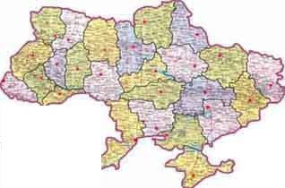
Step 1: Determine Domain and Scope
Domain: family relations
Application: route planning agent
Possible questions:
Distance between two cities?
What sort of connections exist between two cities?
In which country is a city?
How many borders are crossed?
Notes:
[3] -> kendi örneğini geliştir

Slide 5

Step 2: Enumerate Important Terms
city
capital
Connection_on_land
country
border
road
railway
Connection_on_water
currency
Connection_in_air
connection
Notes:
[3] -> kendi örneğini geliştir...

Slide 6
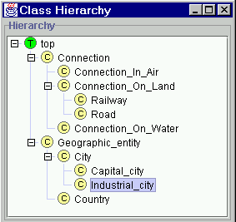
Step 3: Define Classes and Class Hierarchy
Notes:
[3] -> kendi örneğini geliştir

Slide 7
Step 4: Define Slots of Classes
Geographic_entity
End_point
Connection
Country
City
Start_point
Has_capital
Borders_with
Capital_of
Capital_city
Step 5: Define slot constraints
Slot-cardinality
Ex: Borders_with multiple, Start_point single
Slot-value type
Ex: Borders_with- Country
Notes:
[3] -> kendi örneğini geliştir

Slide 8
OWL Example in Protégé (1)
Class
Person superclass
Man, Woman subclasses
Enumerated Classes
Properties
isWifeOf, isHusbandOf
Property characteristics, restrictions
inverseOf
domain
range
Cardinality
allValuesFrom, someValuesFrom, hasValue, minCardinality, maxCardinality, cardinality
Class expressions
disjointWith, unionOf (or), intersectionOf (and), complementOf (not)
Notes:
[3] -> kendi örneğini geliştir
[6]’da detaylar var...

Slide 9
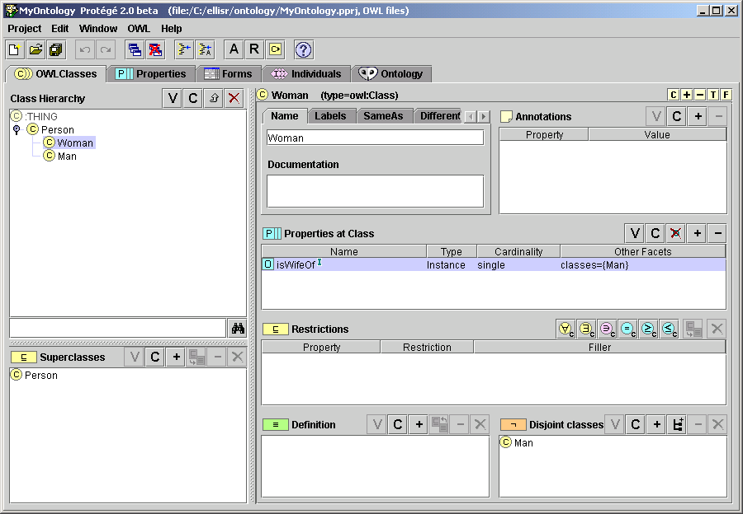
OWL Example in Protégé (2)
Notes:
[3] -> kendi örneğini geliştir

Slide 10
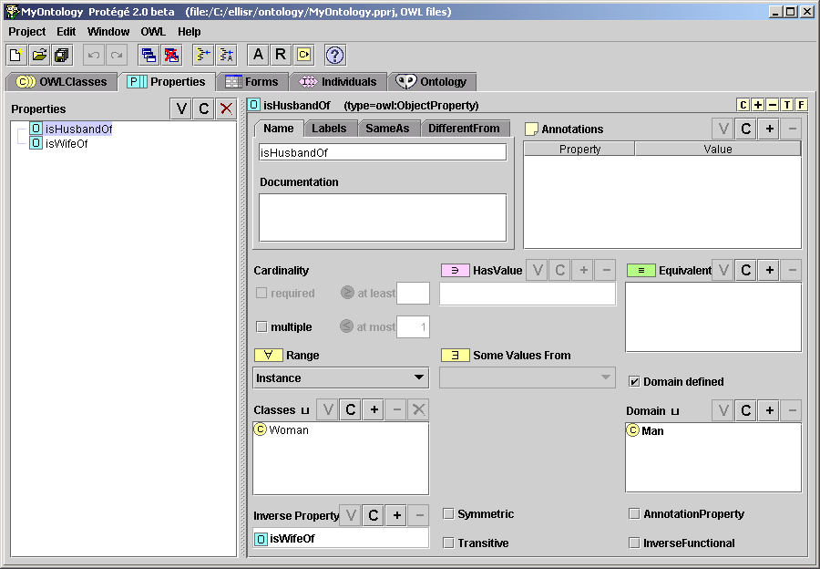
OWL Example in Protégé (3)
Notes:
[3] -> kendi örneğini geliştir

Slide 11
Ontologies vs. Models Acknowledgements: Colin Atkinson
Ontologies
originated from the artificial intelligence world for the purpose of precisely structuring “knowledge”
new “knowledge” derived by automated reasoning
characterized by OWL as the flagship language
formal semantics (description logic)
Models (à la MDA)
originated from the software engineering world for structuring the specification of software, abstracting from platform specific aspects
information defined prescriptively for construction
characterized by UML as the flagship language
semi-formal semantics (metamodels)
Ontologies
?
Models
Notes:
[3]

Slide 12
kaynak\Ian Horrocks - CS646\7.2Lect-2-Ontology-building-2007.ppt

Slide 13
Mola...
Next: Reasoning...

